Slide 1

Topic: WEBRTC APP CHAT AND FILE SHARING
Instructors: Ms. Nguyen Thanh Cam
Students : Le Tran Thu Loan
Nguyen Trung Hieu
Class: 19IT3

Slide 2
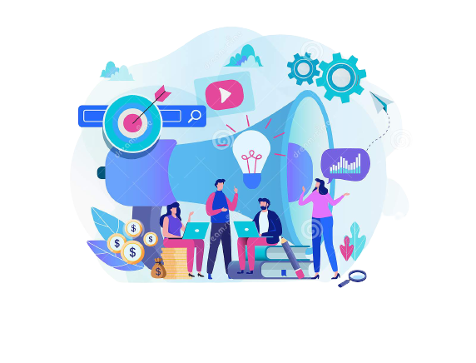
Contents
01
Overview
02
System Analysis And Design
03
04
Building WebRTC
Conclusion and Demo

Slide 3
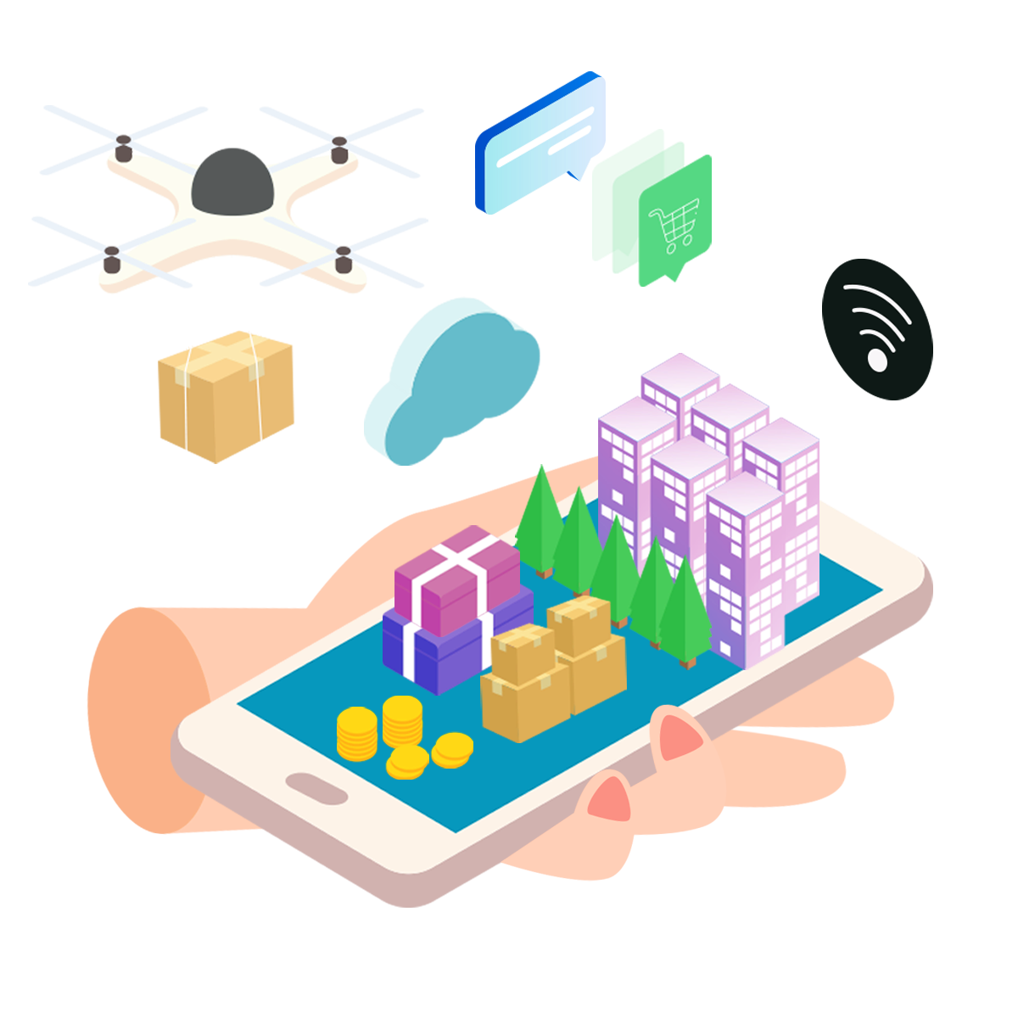
01
OVERVIEW

Slide 4
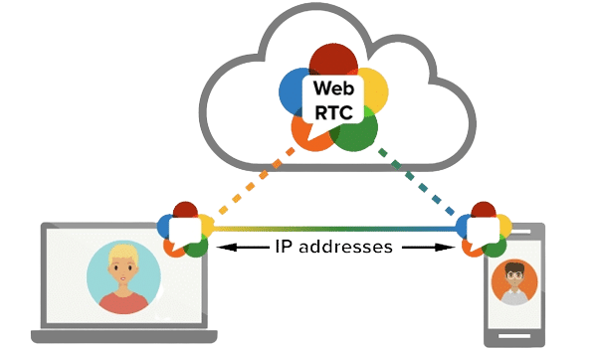
Overview
WEBRTC OVERVIEW
WebRTC (Web Real-Time Communication) is a standard that defines a set of communication protocols and application programming interfaces that enable real-time communication over peer-to-peer connections
Development process
WebRTC was started by Google to build a standard base based on Real time Media Engine (Real time Media Engine) in all browsers. This idea was given by the Google Hangouts development team back in 2009

Slide 5
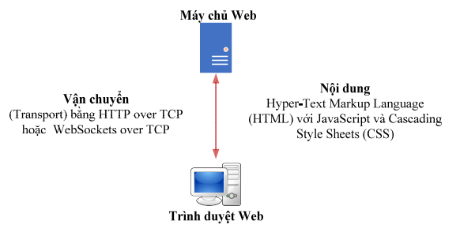
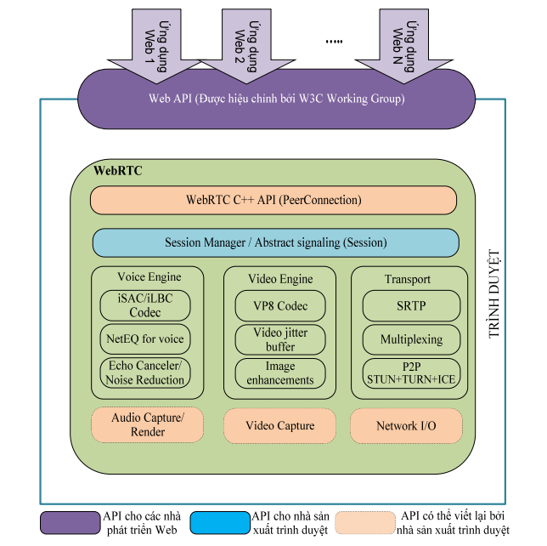
Overview
WebRTC Architecture
Classic web architecture based on the model server, where the browser sends an HTTP request to the server to get the content, the server responds, sending the content back to the browser as HTML, often accompanied by JavaScript and Sheets cascading style (CSS)

Slide 6
OVERVIEW
APIs in WebRTC
RTCPeerConnection API:Encapsulates all connection creation, management, and state in one interface.
MediaStream:The "Media Capture and Stream" specification according to the W3C is defined as a new set of JavaScript APIs that make it possible for an application to request audio and video streams from the underlying platforms, as well as a set of APIs to manipulate and process the data. that media stream
RTCDataChannel:The RTCDataChannel API enables peer-to-peer arbitrary data exchange with low latency and high throughput.

Slide 7
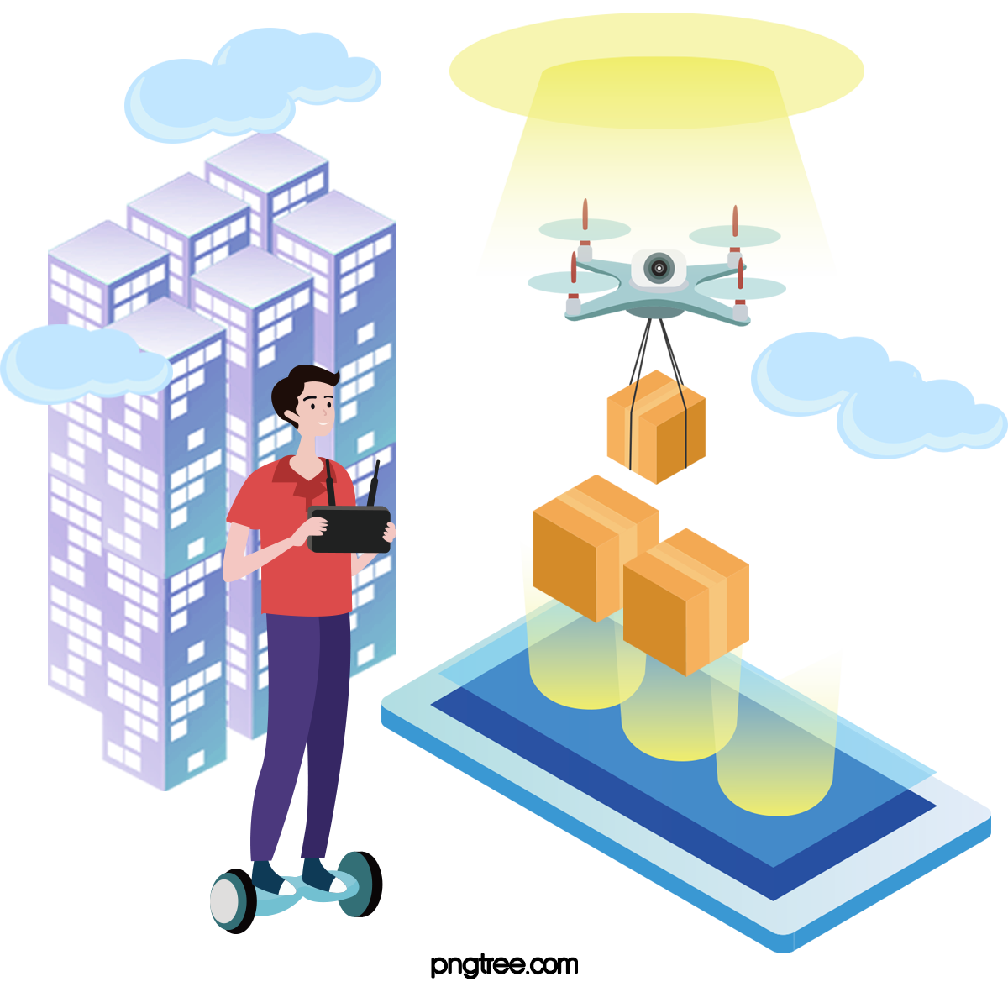
02
System Analysis And Design

Slide 8
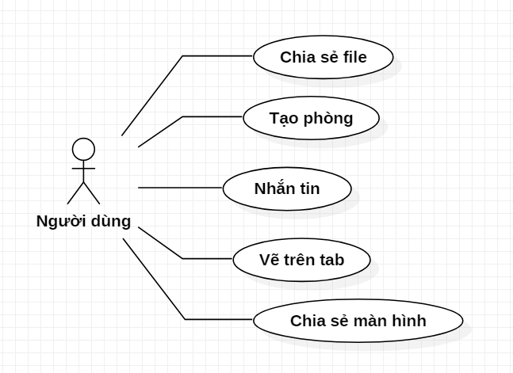
ANALYSIS AND DESIGN
2.1. UseCase Diagram

Slide 9
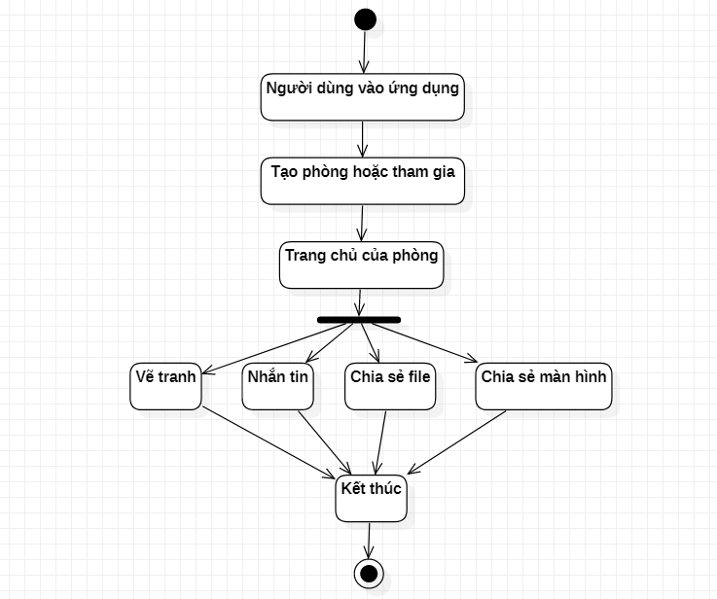
ANALYSIS AND DESIGN
2.2. Activity chart

Slide 10
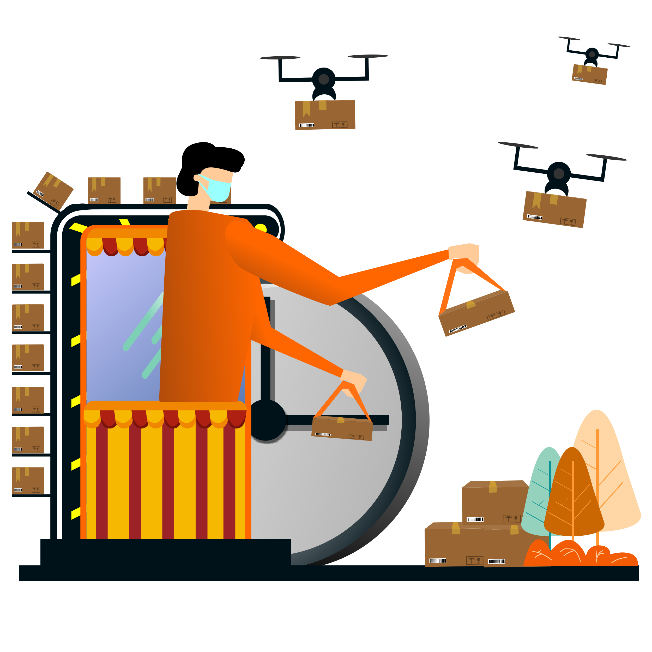
03
Building WebRTC

Slide 11
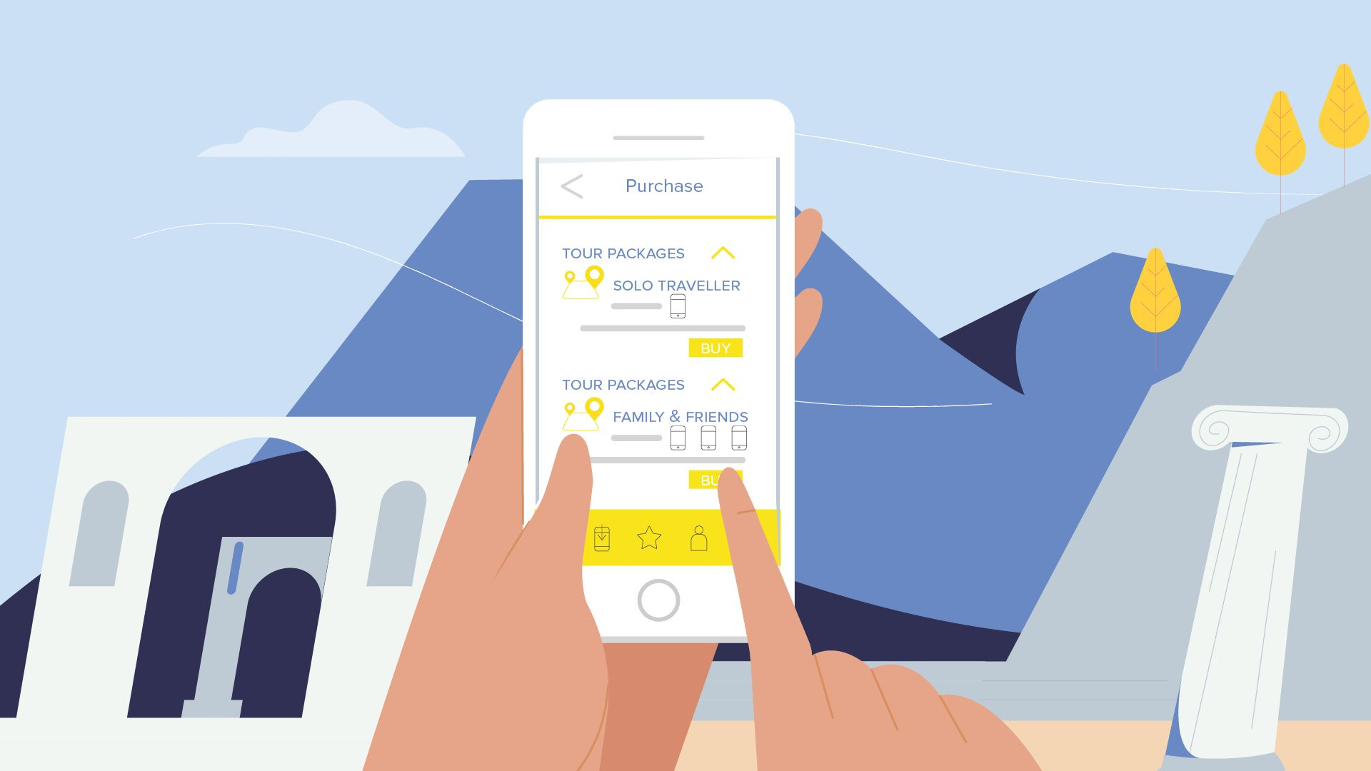
Building WebRTC

Slide 12
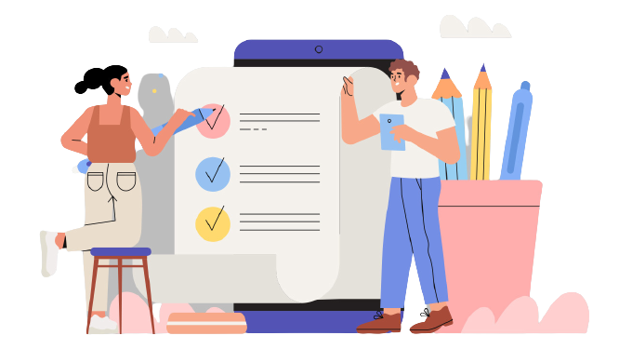
04
Conclusion and Demo

Slide 13
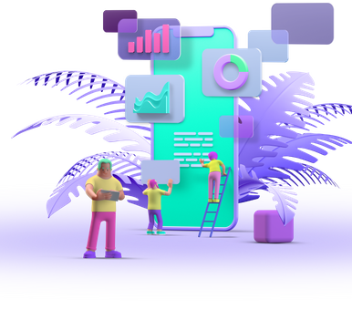
CONCLUSION
Through the project on our team, we also accumulated some experiences as follows:
It helps our team better understand the mechanism and how the peer to peer model and WebRTC work.
Cultivate knowledge and skills in network programming, from which it is possible to develop and build a number of similar WebRTC systems
Consolidate knowledge of UML system design and analysis, draw and manipulate basic types of diagrams such as use-case diagrams, class diagrams, sequence diagrams...
Knowing how to write and use APIs to get data is a very good technology, it helps us to save more time, optimize in terms of database system administration.

Slide 14
04
Demo

Slide 15




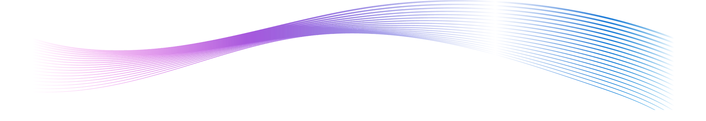



THANK YOU !

